Slide 1

DevOps
What?
History
    – DevOps come into an existence?
    DevOps is an extension to an Agile
    Why Agile?
      Agile Solves Waterfall Model Problem
      Us Vs Them Mentality

Slide 2
Waterfall Model Problem
Business Analyst Prepares Requirement Document
Designer prepare Design
Developers develops the system
Tester Performs Different Testing
  Here 3 Things can happens –
    1. WOW
    2. 80 % Work and 20 Issues
    3. Disaster Happens – 80-90% Functionalities are not working
    Then Customer Says What is this I did not asked for this.
    Blaming Game starts . . .

Slide 3
Waterfall Model Problem
Us Vs Them Mentality
Lack of Communication
Lack of Transparency
Long Feedback Loop –
  Customer involved at the beginning to capture the requirement and then directly during the testing
Because of this many Misunderstanding happens
To solve all these things Agile Comes into picture

Slide 4
What is Agile
Agile is way of working
Collaborative way of working
Customer + BA + Dev + QA
Work together as one team build the software incrementally

Slide 5
DevOps ?
P P T
People (Role)
Processes ( CI /CD Monitoring etc)
Tools ( used to simplify the life and automate the processes)
Jenkins, Sonarcube, jfrog repository, fortify etc
Stitch these tools to create a DevOps pipeline
Generally DevOps Engineer does stitching

Slide 6
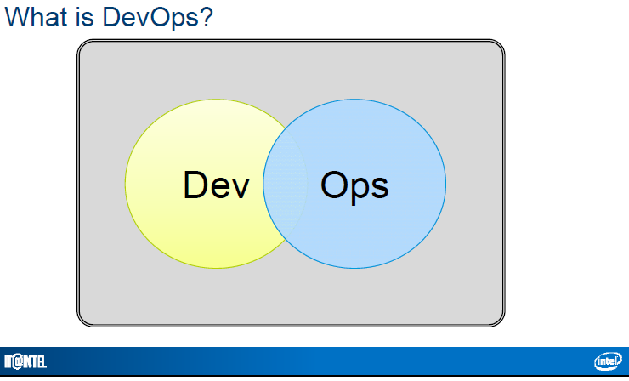
? DevOps
Solves Everyday IT Problems With DevOps
* Source –Solve Everyday IT Problems with DevOps.pdf

Slide 7
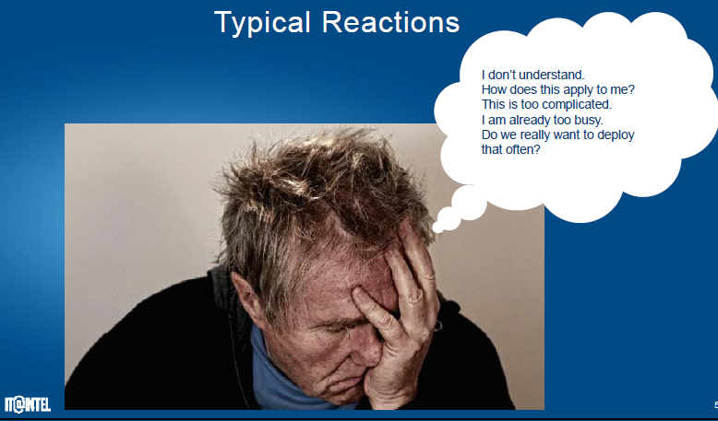
? DevOps
* Source –Solve Everyday IT Problems with DevOps.pdf

Slide 8
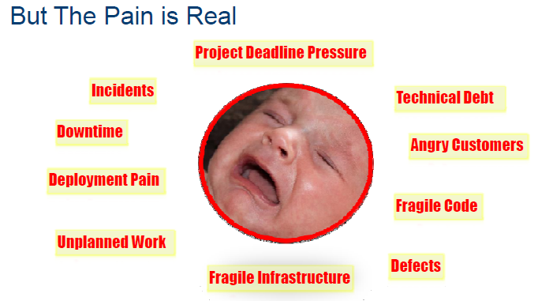
? DevOps
* Source –Solve Everyday IT Problems with DevOps.pdf

Slide 9
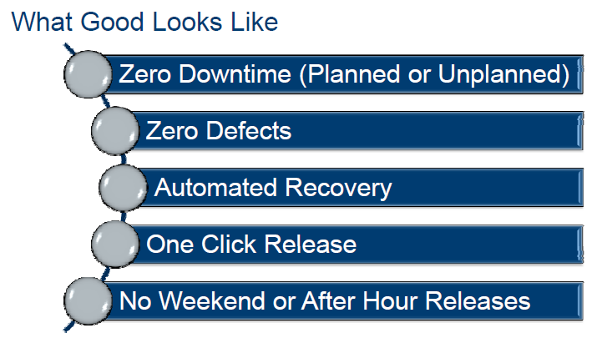
? DevOps
* Source –Solve Everyday IT Problems with DevOps.pdf

Slide 10
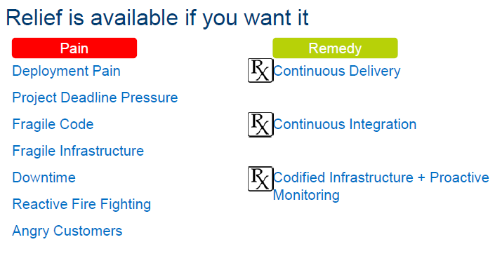
? DevOps
* Source –Solve Everyday IT Problems with DevOps.pdf

Slide 11
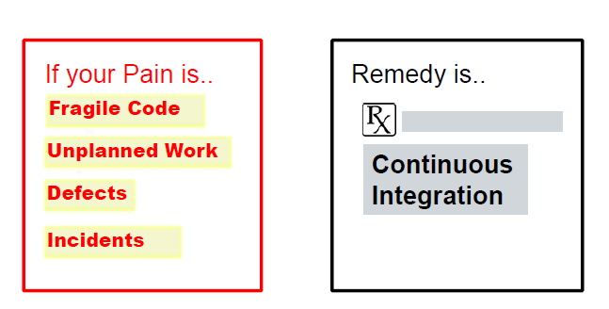
? DevOps
* Source –Solve Everyday IT Problems with DevOps.pdf

Slide 12
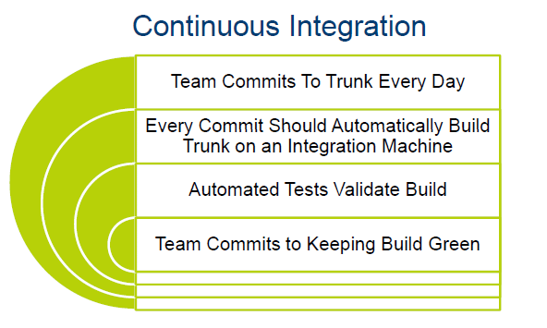
? DevOps
* Source –Solve Everyday IT Problems with DevOps.pdf

Slide 13
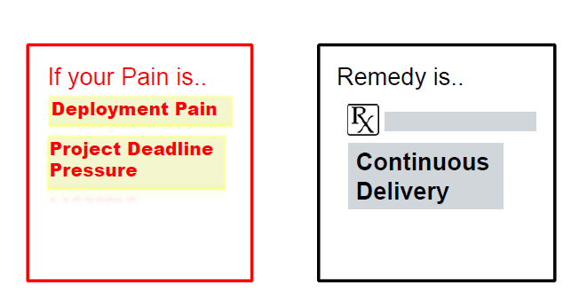
? DevOps
* Source –Solve Everyday IT Problems with DevOps.pdf

Slide 14
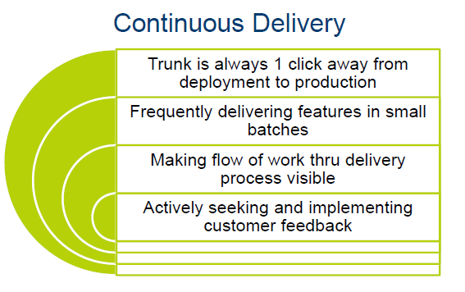
? DevOps
* Source –Solve Everyday IT Problems with DevOps.pdf

Slide 15
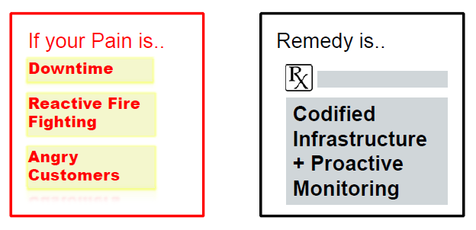
? DevOps
* Source –Solve Everyday IT Problems with DevOps.pdf

Slide 16
DevOps Vs Agile
Agile Values
Agile is governed by the Agile Manifesto, which defines 12 principles
Satisfying the customer is the top priority
Welcome changing requirements, even late in development
Deliver working software frequently
Development and business must work together
Build projects around motivated people
Face-to-face communication is the most efficient and effective method of conveying information

Slide 17
DevOps Vs Agile
Agile Values
The primary measure of success is working software
Agile processes promote sustainable development
Maintain continuous attention to technical excellence and good design
Simplicity is essential
The best architectures, requirements, and designs emerge from self-organizing teams
Regularly reflect on work, then tune and adjust behavior.

Slide 18
DevOps Vs Agile
Agile four Values are
Individuals and interactions over processes and tools
Working software over comprehensive documentation
Customer collaboration over contract negotiation
Responding to change over following a plan

Slide 19
DevOps Vs Agile
Agile | DevOps
Emphasize breaking down barriers between developers and management. | DevOps is about software deployment and operation teams.
Addresses gap between customer requirements and development teams. | Addresses the gap between development and Operation team
Focuses more on functional and non-functional readiness | It focuses operational and business readiness.
Agile development pertains mainly to the way development is thought out by the company. | DevOps emphases on deploying software in the most reliable and safest ways which aren't necessarily always the fastest.
Agile development puts a huge emphasis on training all team members to have varieties of similar and equal skills. So that, when something goes wrong, any team member can get assistance from any member in the absence of the team leader. | DevOps, likes to divide and conquer, spreading the skill set between the development and operation teams. It also maintains consistent communication.
Agile development manages on "sprints. It means that the time table is much shorter (less than a month) and several features are to be produced and released in that period. | DevOps strives for consolidated deadlines and benchmarks with major releases, rather than smaller and more frequent ones.

Slide 20
Disadvantage of Agile
The Product gets tested on developers Computer not on Production System
Developers and Operations Team work in Silos

Slide 21
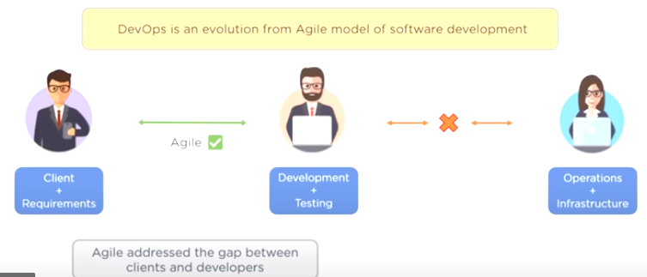
DevOps

Slide 22
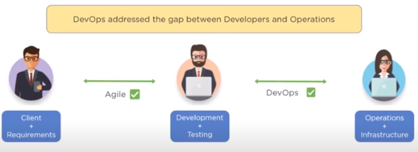
DevOps

Slide 23
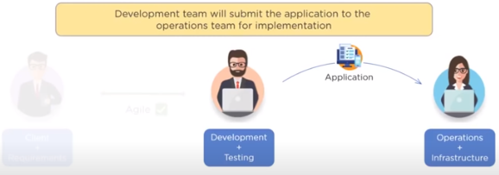
DevOps

Slide 24
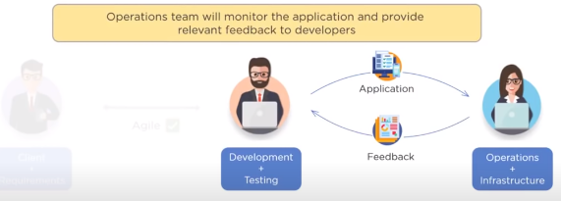
DevOps

Slide 25
Why is DevOps is Needed?
Before DevOps, the development and operation team worked in complete isolation.
Testing and Deployment were isolated activities done after design-build. Hence they consumed more time than actual build cycles.
Without using DevOps, team members are spending a large amount of their time in testing, deploying, and designing instead of building the project.
Manual code deployment leads to human errors in production
Coding & operation teams have their separate timelines and are not in synch causing further delays.

Slide 26
Why is DevOps used?
1. Predictability: DevOps offers significantly lower failure rate of new releases
2. Reproducibility: Version everything so that earlier version can be restored anytime.
3. Maintainability: Effortless process of recovery in the event of a new release crashing or disabling the current system.
4. Time to market: DevOps reduces the time to market up to 50% through streamlined software delivery. This is particularly the case for digital and mobile applications.

Slide 27
Why is DevOps used?
5. Greater Quality: DevOps helps the team to provide improved quality of application development as it incorporates infrastructure issues.
6. Reduced Risk: DevOps incorporates security aspects in the software delivery lifecycle. It helps in reduction of defects across the lifecycle.
7. Resiliency: The Operational state of the software system is more stable, secure, and changes are auditable.
8. Cost Efficiency: DevOps offers cost efficiency in the software development process which is always an aspiration of IT companies' management.
9. Breaks larger code base into small pieces: DevOps is based on the agile programming method. Therefore, it allows breaking larger code bases into smaller and manageable chunks..

Slide 28
When to Use / Not to Use DevOps
When to adopt DevOps?
DevOps should be used for large distributed applications such as eCommerce sites or applications hosted on a cloud platform.
When not to adopt DevOps?
It should not be used in a mission-critical application like bank, power and other sensitive data sites. Such applications need strict access controls on the production environment, a detailed change management policy, access control policy to the data centers.

Slide 29
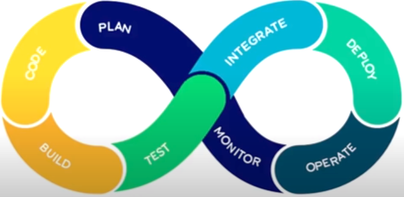

DevOps Lifecycle / Phases
1. PLAN
In Plan Stage, business owners and software development team discuss project goals and create a plan

Slide 30
DevOps Lifecycle / Phases
1. Plan
Purpose
  Gather business requirements
  Define project goals
  Create product backlog
  Sprint planning
Common Tools
  Jira
  Azure Boards
  Trello
  Confluence
Output: User stories, project roadmap, sprint backlog

Slide 31

DevOps Lifecycle / Phases
2. Code
Programmer then design and code the application and use tools like Git to store application code

Slide 32
DevOps Lifecycle / Phases
Development
Write application code
Version control
Code review
Tools
Git
GitHub
GitLab
2. Code

Slide 33

DevOps Lifecycle / Phases
3. Build
Build Tools like Maven and Gradle, take code from different repositories and combine them to build the complete application

Slide 34
DevOps Lifecycle / Phases
Build
Compile source code
Package application
Dependency management
Tools
Maven
Gradle
npm
Output: Build artifacts
3. Build

Slide 35

DevOps Lifecycle / Phases
4. Test
Application is tested using automation testing tools like Selenium and JUnit to ensure software quality

Slide 36
DevOps Lifecycle / Phases
Types of Testing
  Unit Testing
  Integration Testing
  Functional Testing
  Performance Testing
  Security Testing
Tools
  Selenium
  JUnit
  TestNG
  Cypress
  SonarQube
  JMeter
Goal: Ensure software quality before deployment.
4. Test

Slide 37

DevOps Lifecycle / Phases
5. INTEGRATE
When testing is complete, new features are integrated automatically to already existing codebase

Slide 38
DevOps Lifecycle / Phases
Purpose
  Automatically integrate code changes into a shared repository.
Benefits
  Early bug detection
  Automated builds
  Faster feedback
Popular CI Tools
  Jenkins
  GitHub Actions
  GitLab CI/CD
  Azure Pipelines
  CircleCI
5. Integrate

Slide 39
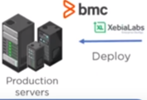
DevOps Lifecycle / Phases
6. DEPLOY
Application is packaged after release and deployed from development server to production server

Slide 40
DevOps Lifecycle / Phases
Release
  Approve software version
  Create release notes
Deployment
  Deploy to staging
  Deploy to production
  Rollback if needed
Deployment Strategies
  Blue-Green Deployment
  Canary Deployment
  Rolling Deployment
Tools
  Docker
  Kubernetes
  Helm
  Argo CD
  Ansible
6.Deploy

Slide 41

DevOps Lifecycle / Phases
7. Operate
Once Software is deployed, operations team perform activities such as configuring servers and provisioning them with required resources

Slide 42
DevOps Lifecycle / Phases
Operations
  Infrastructure management
  Incident management
  Performance optimization
Tools
  Kubernetes
  Docker
  OpenShift
  Ansible
  Terraform
  Chef
  Puppet
6.Operate

Slide 43

DevOps Lifecycle / Phases
8. MONITOR
Monitoring allows IT organization to identify specific issues of specific releases and understand the impact on end-users

Slide 44
DevOps Lifecycle / Phases
Monitoring
  CPU & Memory
  Logs
  Errors
  User Experience
Tools
  Prometheus
  Grafana
  ELK Stack
  Splunk
  Datadog
  Nagios
6.Monotor

Slide 45
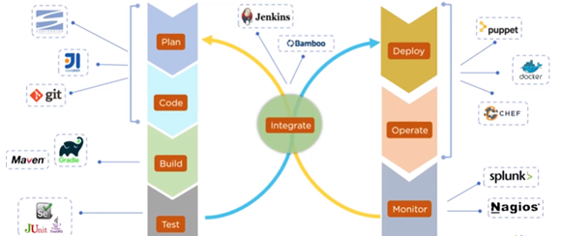
DevOps Tools

Slide 46
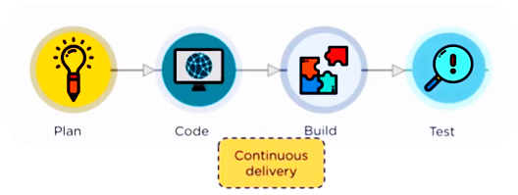
DevOps Process

Slide 47
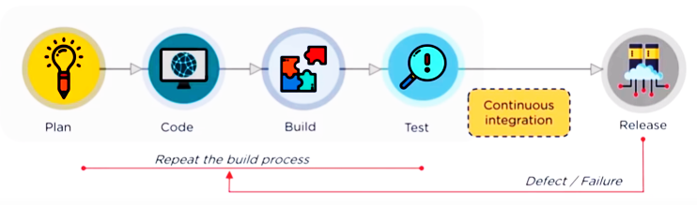
DevOps Process

Slide 48
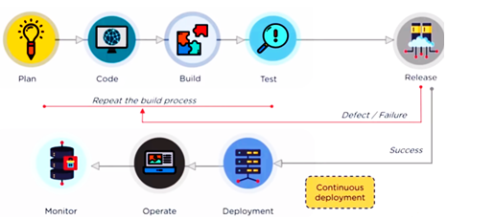
DevOps Process

Slide 49
Continuous Integration
Continuous integration is a software development method where members of the team can integrate their work at least once a day. In this method, every integration is checked by an automated build to search the error.
The CI concept was first introduced over two decades ago to avoid "integration hell," which happens when integration is put off till the end of a project.
In Continuous Integration after a code commit, the software is built and tested immediately.
In a large project with many developers, commits are made many times during a day. With each commit code is built and tested. If the test is passed, build is tested for deployment. If the deployment is a success, the code is pushed to Production. This commit, build, test, and deploy is a continuous process, and hence the name continuous integration/deployment.

Slide 50
What we will Learn about CI
What is Continuous Integration?
Development without CI vs. Development with CI
Difference between Compilation and Continuous Integration
What do you need to conduct CI process?
How Continuous integration work?
Features of CI
Why Use CI?
Best practices of using CI
Disadvantages of CI
Tools for CI process

Slide 51
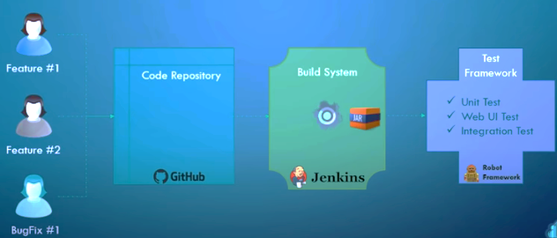
What is Continuous Integration?

Slide 52
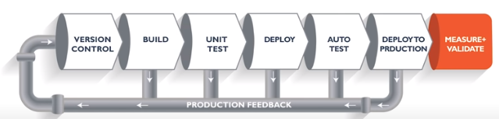
What is Continuous Integration?

Slide 53
Development without CI vs. Development with CI
Development without CI | Development with CI
Lots of Bugs | Fewer bugs
Infrequent commits | Regular commits
Infrequent and slow releases | Regular working releases
Difficult integration | Easy and Effective Integration
Testing happens late | Testing happens early and often.
Issue raised are harder to fix | Find and fix problems faster and more efficiently.
Poor project visibility | Better project visibility

Slide 54
Difference between Compilation and Continuous Integration
The following are the activities need to carry out in Continuous Integration
DB Integration
Code Inspection
Automated Development
Document Generation
Compilation

Slide 55
Difference between Compilation and Continuous Integration
DB Integration
  Ensure DB and code in sync
  Automated creation of DB and test data
Code Inspection:
  Ensures a healthy codebase
  Identifies problems early and applies best practices

Slide 56
Difference between Compilation and Continuous Integration
Automated Deployment:
  Allows you to release product anytime
  Continually demo-able state and it is works on any machine
Document generation:
  Ensure documentation is current
  Removes burned from the developer
  Produces build reports and metrics

Slide 57
Difference between Compilation and Continuous Integration
Compilation:
  Compilation is the process the computer takes to convert a high-level programming language code into a machine language that the computer able to understand. It ensures a code compiler on every target platform.
When do I build?
  At every check-in
  Every time a dependency changes

Slide 58
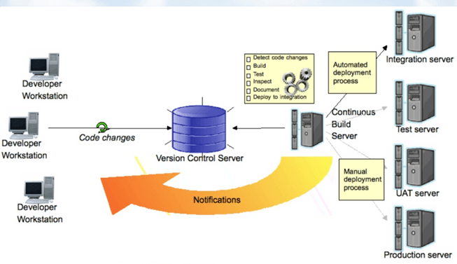
CI Process

Slide 59
CI Process
Ideally, the build should come from the command line and should not depend on IDE.
The build should happen continuously using a dedicated Cl server, not a cron job.
CI built should be triggered on every check-in and not just at midnight
The build should provide immediate feedback and Require no developer effort
Identify key metrics and track them visually. More importantly, act on them immediately

Slide 60
What do you need to conduct CI process?
Here, are the key elements which we need to perform the entire CI process:
Version Control System (VCS): It offers a reliable method to centralize and preserve changes made to your project over time.
Virtual Machine: You should have a spare server or at least one virtual machine to build your system.
Hosted CI Tool Solutions: To avoid servers or virtual machines, you should go for hosted CI tool solutions. This tool helps in the maintenance of the whole process and offers easier scalability.
Tools: If you select a self-hosted variant, you will need to install one of the many CI tools like Jenkins, TeamCity, Bamboo, GitLab, etc.

Slide 61
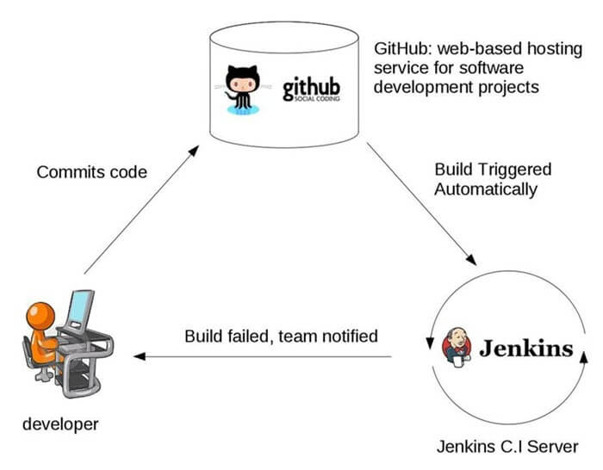
Example of integration work

Slide 62
Features of CI
Here, are important features of Continuous Integration
Allows you to maintain just a single source repository
You can test the clone of the production environment
The built environment should be close to the production environment.
Constant availability of a current build
The complete process of build and testing and deployment should be visible to all the stack holders.

Slide 63
Why Use CI?
Helps you to build better quality software
CI process helps to scale up headcount and delivery output of engineering teams.
CI allows software developers to work independently on features in parallel.
Helps you to conduct repeatable testing
Increase visibility enabling greater communication
Helps develop a potentially shippable product for fully automated build
Helps you to reduced risks by making deployment faster and more predictable
immediate feedback when issue arrives
Avoid last-minute confusion at release date and timing

Slide 64
Best practices of using CI Systems
Commit Early and Commit Often never Commit Broken Code
Fix build failures immediately
Act on metrics
Build-in every target environment Create artifacts from every build
The build of the software need to be carried out in a manner so that it can be automated
Do not depend on an IDE
Build and test everything when it changes

Slide 65
Best practices of using CI Systems
The database schema counts as everything
Helps you to find out key metrics and track them visually
Check-in often and early
Stronger source code control
Continuous integration is running unit tests whenever you commit code
Automate the build and test everyone
Keep the build fast with automated deployment

Slide 66
Disadvantages of CI
Initial setup time and training is required to get acquainted with Cl server
Development of suitable test procedures is essential
Well-developed test-suite required many resources for Cl server
Conversion of familiar processes
Requires additional servers and environments
Waiting times may occur when multiple developers want to integrate their code around the same timet

Slide 67



Some of the Tools for CI process
Jenkins is an open-source continuous integration tool. It is written using the Java programming language. It facilitates real-time testing and reporting on isolated changes in a more massive codebase. This software helps developers to quickly find and solve defects in their codebase & automate testing of their builds.
Bamboo is a continuous integration build server that performs - automatic build, test, and releases in a single place. It works seamlessly with JIRA software and Bitbucket. Bamboo supports many languages and technologies such as CodeDeply, Ducker, Git, SVN, Mercurial, AWS, and Amazon S3 buckets.
TeamCity is a Continuous Integration server that supports many powerful features. It maintains a CI server healthy and stable even when no builds are running. It provides better code quality for any project

Slide 68
Summary of CI
Continuous integration is a software development method where members of the team can integrate their work at least once a day
Development without CI creates lots of bugs whereas Development with CI offers Fewer bugs
Important activities of Contineous Integration are 1) DB integration, 2) Code Inspection, 3) Automated Deployment, Document generation, and Compilation.
The build should happen continuously using a dedicated Cl server, not a cron job.

Slide 69
Summary of CI
Important elements of CI are 1) Version Control System 2) Virtual Machine 3) Host CI Tool solutions 4) Tools
Continuous Integration allows you to maintain just a single source repository
CI process helps you to build better quality software
The most important best practices of Continuous Integration process is to Commit Early and Commit Often never Commit Broken Code
The major drawback of the CI process is that well-developed test-suite required many resources for Cl server
Jenkins, Bambook, and Team City are some useful Continuous Integration tools.

Slide 70
Todays Practical Activities
Configure a system
Email Notification
MJ – Global Tool Configuration
MJ Configure Global Security
MJ – Assign the Role
Configuration with git and Execution of Java Program
Using and Maven Application
Tomcat
VS Code and Git

Slide 71
Practical Activities
User Creation and Assigning a roles
Execution of Java Program through Jenkins
Execution of Java Program through Jenkins when it is available on GitHub
Parameterized Jobs
Extended Choice Parameters Job
Chain Job Execution

Slide 72
Practical Activities
Creation of Pipeline
Groovy Scripted Pipeline
Groovy Scripted Pipeline using Git
Automatic Deployment of Job

Slide 73
Practical Activities
1. Create a java program and run it through command line
2. Create a Jenkins job to run the java program
3. Add this program/project to Git
4. Jenkins - add git plugin
5. Configure Jenkins job to trigger the execution when a change is pushed to GitHub

Slide 74
Practical Activities
Step 1 : Create a java program
Step 2 : Compile from command line
javac “name of .java class”
java “name of class without extension .java”
Step 3 : Create a Jenkins job to run this program
Step 4 : Add the project to Git and GitHub

Slide 75
Jenkins Pipeline
What is Jenkins?
What is Continuous Integration
Why Pipeline
How Does Jenkins Pipeline Works
Demo on Jenkins Pipeline

Slide 76
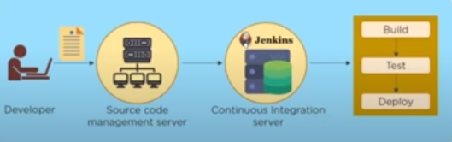
What is Jenkins?
Jenkins is an open source Continuous Integration server written in java that allows continuous development , test and deployment of codes

Slide 77
What is Continuous Integration?

Slide 78
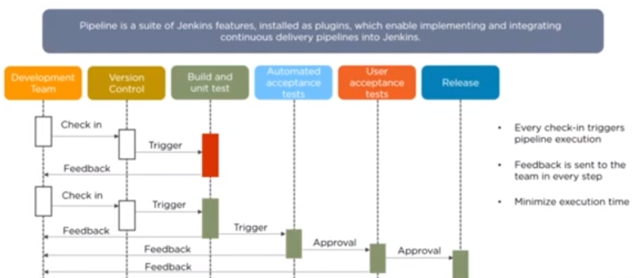
What is Pipeline in Jenkins?

Slide 79
Practical Activity
Create Three Jobs
Create their Pipeline as discussed
Install Delivery Pipeline Plugin for Visualization
Visualize the pipeline
Create a Scripted Pipeline using Groovi Script ( Direct Coding)
Create a Scripted Pipeline using Groovi Script from Source Code repository

Slide 80
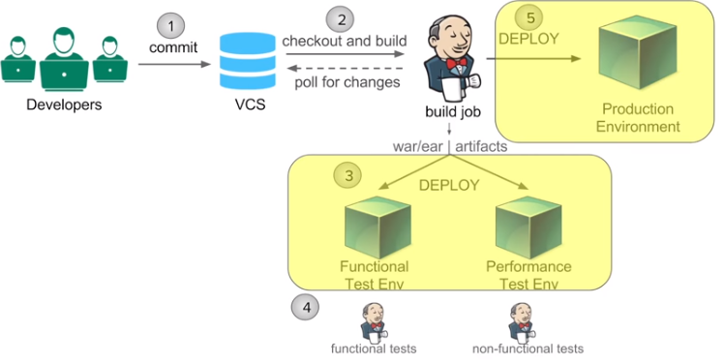
Practical Activity

Slide 81
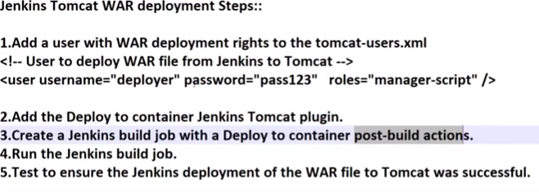
Practical Activity

